Slide 1

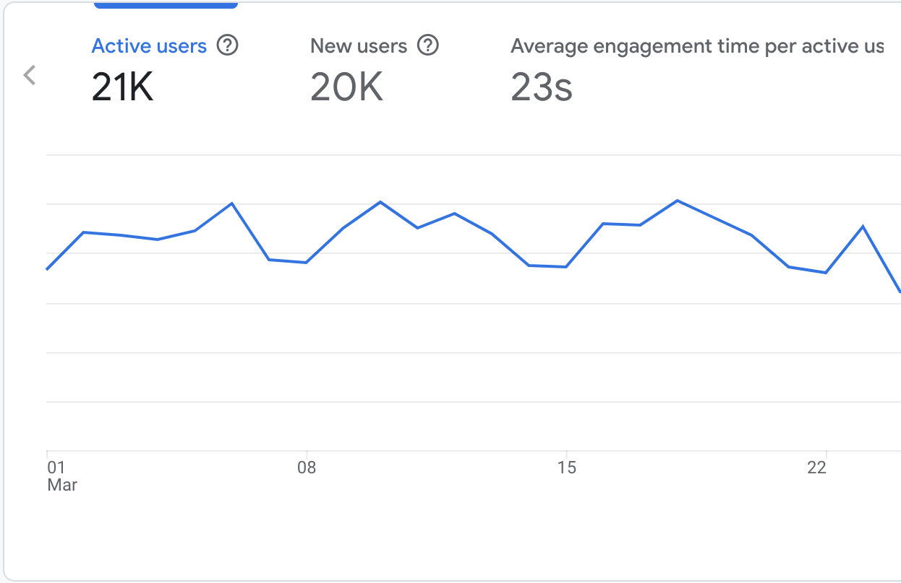

Website Performance Report
Analysis & Strategic Insights
March,2026

Slide 2
Executive Summary
Performance Overview: Strong Foundation with Clear Growth Opportunities
The Delta Beverages website delivered strong overall performance for the period under review, attracting 21,000 active users, with an impressive 95.2% being new visitors. This high proportion of first-time users signals effective audience acquisition and continued brand discovery across digital channels.
From a search performance perspective, the website achieved a 2.9% click-through rate (CTR), indicating that search listings are resonating well with user intent and successfully converting visibility into traffic. This reflects solid keyword alignment and compelling search metadata.
The combination of high new-user acquisition and healthy CTR suggests that Delta maintains strong online visibility and sustained interest from external audiences, particularly those discovering the brand for the first time.
Overall, the website demonstrates a stable and growing digital presence, supported by strong discovery metrics and consistent search engagement. The next phase of optimisation can focus on deepening engagement and converting this high influx of new visitors into repeat users and long-term brand advocates.
21K
Active Users
95.2%
N ew Visitors
2.9%
CTR

Slide 3

Site Overview
User Engagement Metrics: 29K Strong Active User Baseline
21,000
Total Active Users
20,000
New Users (96.9%)
23s
Avg Engagement Time
March 2026 reflects strong and consistent performance for the Delta Beverages website. The platform attracted 21,000 active users, with 20,000 (approximately 96%) being new visitors, indicating continued strong brand discovery and effective reach strategies.
The high proportion of new users suggests that awareness efforts — whether through organic search, recruitment interest, or broader brand visibility — are successfully driving first-time traffic to the site. This
demonstrates that Delta remains highly discoverable and relevant within its market.
The average engagement time of 23 seconds is a particularly strong performance indicator. This reflects meaningful user interaction beyond simple page visits, suggesting that visitors are actively consuming content rather than bouncing quickly. Compared to typical corporate website benchmarks, this engagement duration signals solid content relevance and user experience structure.

Slide 4
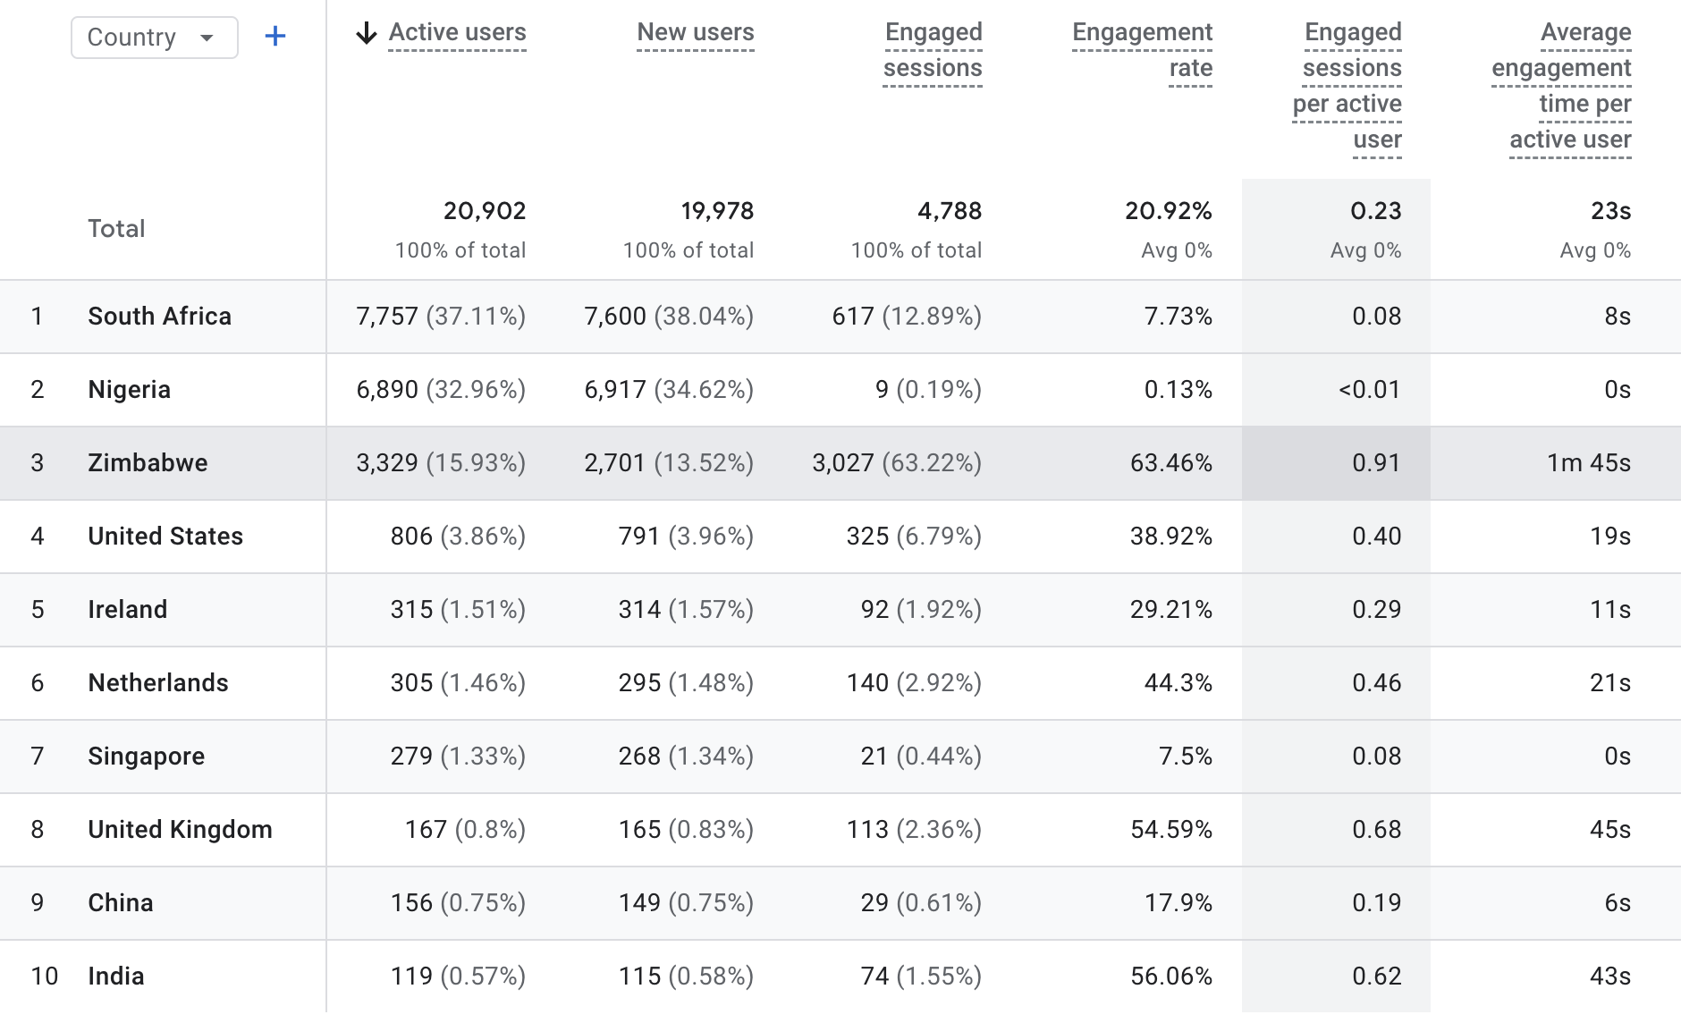
Geographic Performance
Zimbabwe Dominance with International Opportunity
Geographic analysis highlights South Africa as the primary market, contributing 7,757 users (37.11% of total traffic). More importantly, South Africa shows a weaker engagement quality, with a 12.89% engagement rate, 0.08 engaged sessions per user, and a poor 8 seconds average engagement time.
Nigeria represents the second-largest traffic source with 6,890 users (32.96%), followed closely by Zimbabwe at 3,329users (15,93%). However, engagement from Nigeria is significantly lower. Nigeria records a 0.13% engagement rate and just 0 seconds average engagement time, while Zimbabwe shows a staggering engagement at 63.46% and 1 minute 45 seconds average time, suggesting either
low-intent traffic, misaligned targeting, or potential acquisition quality issues.
Interestingly, smaller international markets demonstrate stronger engagement efficiency despite lower volumes.
The United States (806 users) records a 38.92% engagement rate and 19 seconds average engagement time, indicating high-quality visits.
Irelandf (315 users) shows a 29.21% engagement rate and 11 seconds average engagement time.
Singapore (279 users) also performs well with a 7.5% engagement rate and over 0 seconds average engagement time.
The United Kingdom (167 users) contributes moderate volume with a healthy
54.59% engagement rate and 45 seconds average engagement time.
These patterns suggest that while South Africa has volume but lack depth of engagement, certain International markets particularly the USA and Ireland demonstrate strong engagement quality and potential conversion value.

Slide 5
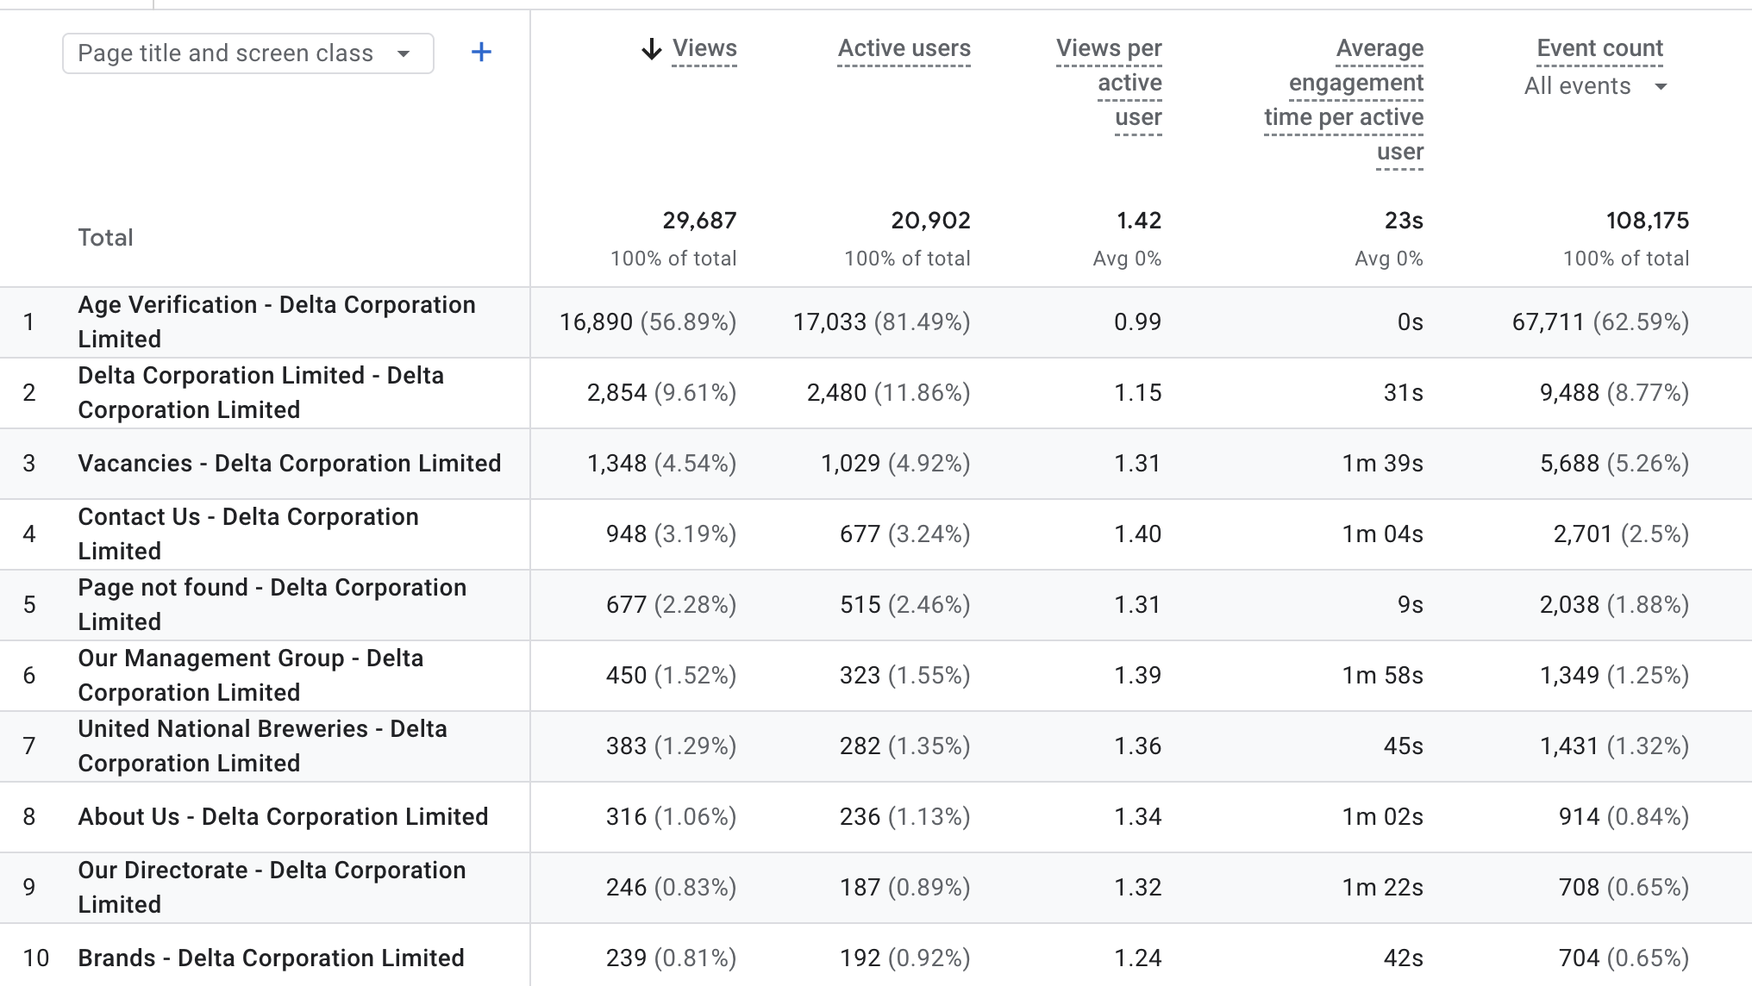
Page Performance
The Homepage and Vacancies pages drive meaningful engagement.
Overall Insight:
The Age Verification page drives volume but not engagement
(functional gateway).
The Homepage and Vacancies pages drive meaningful engagement.
Recruitment content is the strongest engagement pillar on the
site.
Corporate information pages support credibility but are not primary traffic drivers.
Recommendations:
Since recruitment drives strong engagement, we suggest highlighting vacancies more prominently on the homepage.
Use homepage modules to convert job-seekers into longer-term brand followers (e.g., newsletter sign-ups or company updates).
In summary, while compliance and recruitment dominate traffic
patterns, the site has clear opportunity to leverage high-intent job traffic to deepen overall brand engagement.

Slide 6
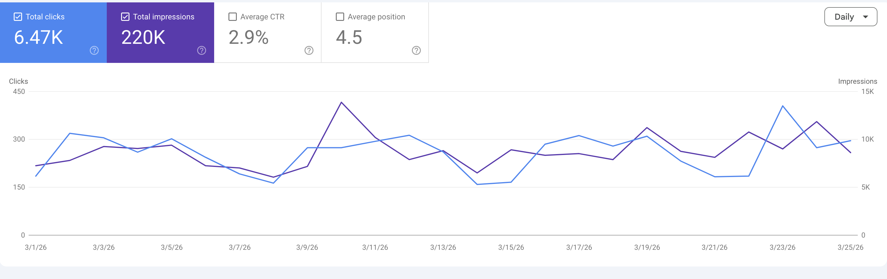
Search Performance
Solid Foundation with Room for Visibility Improvement
The website’s search engine performance demonstrates strong visibility and steady organic traction. The site generated 220K total impressions, resulting in 6.47K clicks, and achieved an average click-through rate (CTR) of 2.9%.
A 2.9% CTR reflects an average baseline performance, indicating that search listings are reasonably aligned with user intent and effectively converting impressions into visits. With over half a
million appearances in search results, the website shows strong keyword presence and discoverability within its category.
However, the average search position of 4.5 highlights meaningful growth opportunity. While ranking on page one provides visibility, positions outside the top five typically capture significantly fewer clicks.
Overall Insight:
Strong organic visibility (high impressions).
Healthy CTR performance.
Page-one presence, but not yet top-tier dominance.
Recommendations:
We propose developing targeted content clusters to build topical authority and improve rankings.

Slide 7
Recommendations
Three Key Initiatives to Enhance Performance
Leverage Recruitment Strength to Deepen Brand Storytelling
The website is clearly performing well in recruitment, with Vacancies and Apprenticeship pages driving strong engagement and repeat visits.
Opportunity:
Build on this success by subtly integrating more corporate storytelling within these high-traffic areas.
Introduce “Life at Delta” highlights within career pages.
Showcase employee stories or culture content alongside vacancies.
Optimise the Age Verification Journey for Brand Continuity
The Age Verification page effectively manages compliance while handling the majority of user entry traffic.
Opportunity:
Enhance the transition experience to create stronger brand continuity:
Introduce subtle brand visuals or messaging within the verification screen.
Use this touchpoint to reinforce brand tone and consistency.
Build on Strong Search Visibility to Increase Market Share
With 220K impressions and solid page-one visibility (average position 4.5), the website has established a strong organic foundation.
Opportunity:
Focus on ranking uplift for already-performing keywords:
Strengthen content depth around recruitment, corporate, and sustainability themes by introducing content blogs.

Slide 8
THANK YOU

